Slide 2
COPY/PASTE FROM POWERPOINT INTO WORD
SIMPLE*
Simple graphics copy over well and may require some light tweaking in Word.
COMPLEX*
Complex graphics with curved text or 3D text may not copy over well. (See slide 4 for a solution.)
TROUBLE TICKETS
3 Tier Escalation Standard Operating Procedure (SOP):
INNOVATION I AGILE I QUALITY I STRATEGY I PLANNING I CONTINUOUS IMPROVEMENT I SAFETY I GOVERNANCE I METRICS I TRANSPARENCY I
Tier 3 issues are resolved by an IT service mechanic (Time: less than 1 day)
Tier 2 issues are resolved by remote IT service technician (Time: 5-30 minutes)
Tier 1 issues are resolved automatically via the AI system (Time: 1-10 mins)
*Newer versions of Word have fewer issues when using copy/paste.
PRO TIP: Make your slide the same width as the size it will be in Microsoft Word (or other app). For example, if you have an 8.5 inch Word page with 1 inch margins, size your slide to be 6.5 inches wide by whatever height (9 inches is almost always safe). To scale your slide in PowerPoint, go to the Design tab and selected Slide Size > Custom Slide Size. (To ensure the font size is the same from PowerPoint to Word, do not scale the image. If the dimensions stay the same, so does the font size.)

Slide 3
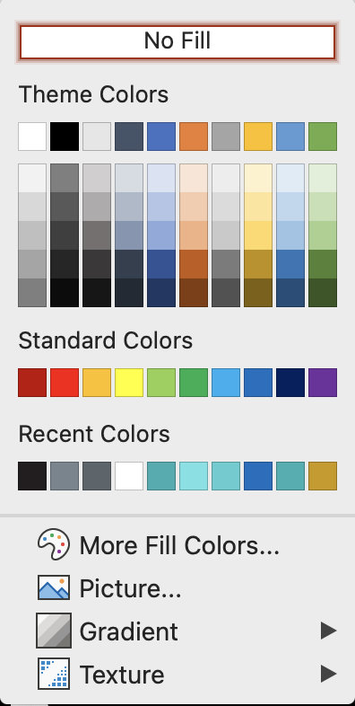
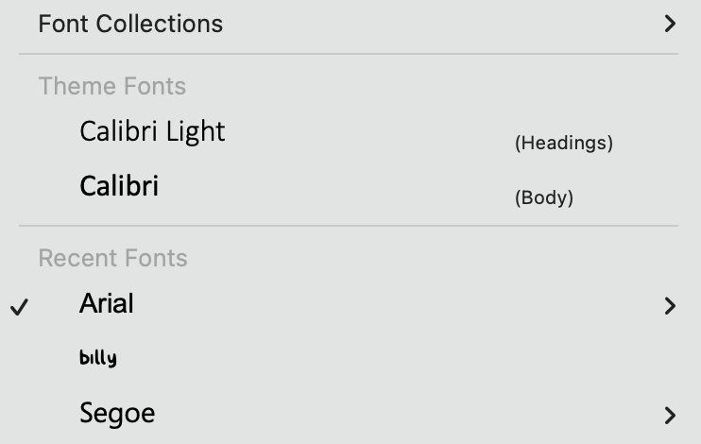
STOP COLORS FROM CHANGING
Recoloring graphics using the Theme Colors means that when a user copy/pastes the graphic into a file that uses ANOTHER Theme (in PowerPoint or Word), the colors will switch to those new Theme colors. Avoid Theme colors unless your files are always using the same Theme.
Recolor graphics using the Standard Colors or Recent Colors to stop the colors from changing when you copy/paste. You can change/add Recent Colors by creating new colors via More Fill Colors and More Colors (under Format Shape’s color options).
NOTE: Build-a-Graphic uses Recent Colors by default to avoid colors changing.
NOTE: The same is true for Theme Fonts.

Slide 4
EXPORT HIGH ESOLUTION IMAGES FROM POWERPOINT
Windows OS (Option 1) STEP 1: In PowerPoint, choose Save As and select PDF. Save the PDF somewhere you can find it. STEP 2: Go to https://cloudconvert.com and chose Selected File > From My Computer and find your PDF. STEP 3: Under Covert To, selected Image > JPG. STEP 4: Click the wrench icon and enter Pixel Density as 300 and Quality at 80 (leave the rest blank). Click Convert. When complete click Download and save your JPG where you can find it. STEP 5: In Word, go to Insert > Pictures > From This Device and find your JPG to insert it. STEP 6: Crop or scale as needed.
Windows OS (Option 2) Invest in the ImageExport PowerPoint add in: http://www.pptools.com/imageexport
Windows OS (Option 3) Follow these instructions: https://learn.microsoft.com/en-us/office/troubleshoot/powerpoint/change-export-slide-resolution
Mac OS STEP 1: In PowerPoint, choose Save As and select PDF. Save the PDF somewhere you can find it. STEP 2: In Word, choose the Insert tab and choose Object > Object… > From File and find your PDF to insert it. STEP 3: Crop or scale as needed.

